Slide 1
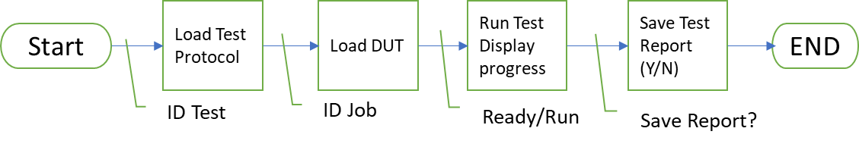
Overview Automated Oil Level Test
Production User Objectives
Wants to automate the Elevate OLS (Oil Level Sensor) ATP Test.
Record resistor value and level switch point measurement.
Engineering/ Maintenance User
Wants to update/add test protocol parameters by saving a new XL Config File.
Wants to calibrate the test bench.
Wants to analyze data.

Slide 2
Documentation for Release
Have
ATP Spec
ATP Test Algorithm (ppt)
Preliminary Requirements
LabVIEW Source Code (GITHUB)
Need - Controlled Artifacts.
Revised Requirements (Assess)
Program Design Spec (Develop)
Interface PCB Design
Design Review Minutes (Validation)
Test Plan
Test Record (Verification)
Release to Production
Program LabVIEW Run-Time
Calibration Plan
Gage R & R Qualification Record
Configuration File
ATP Report Template

Slide 3
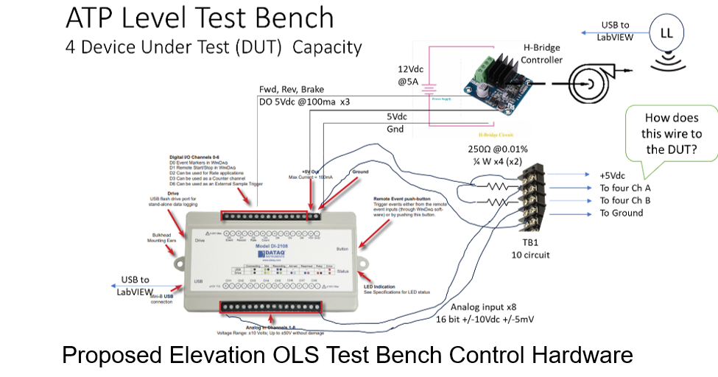

Slide 4
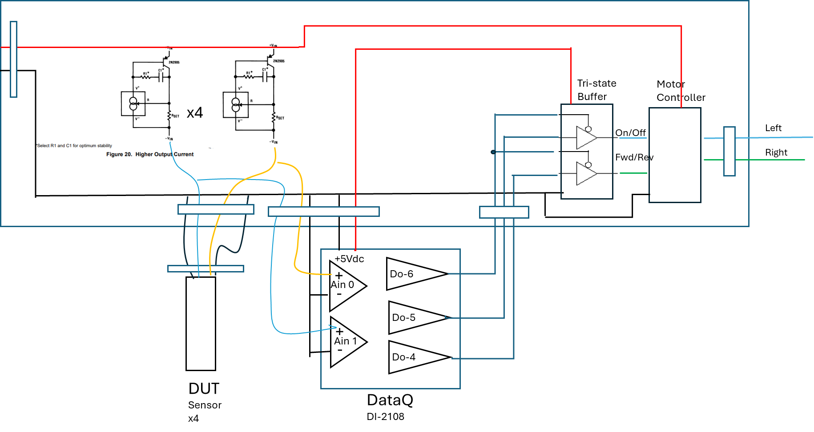
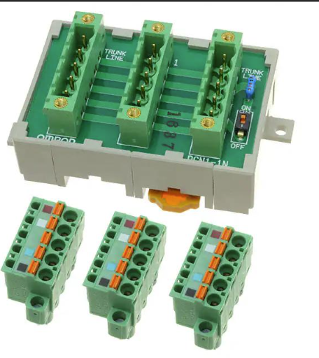
Elevate Interface PCB
Vdc
Power
Supply
Vdc
Power
Supply
74xx125
14ma
LT3092
Pump
20 Pin Ribbon Connector
Only 1 motor control for 3 I/F PCB
=
Prefer to have some pump speed control. Perhaps an LTC6990 PWM that with a BCD to analog switch decoder 74xx4051 to be controlled from 3 digital outputs of DataQ.

Slide 5
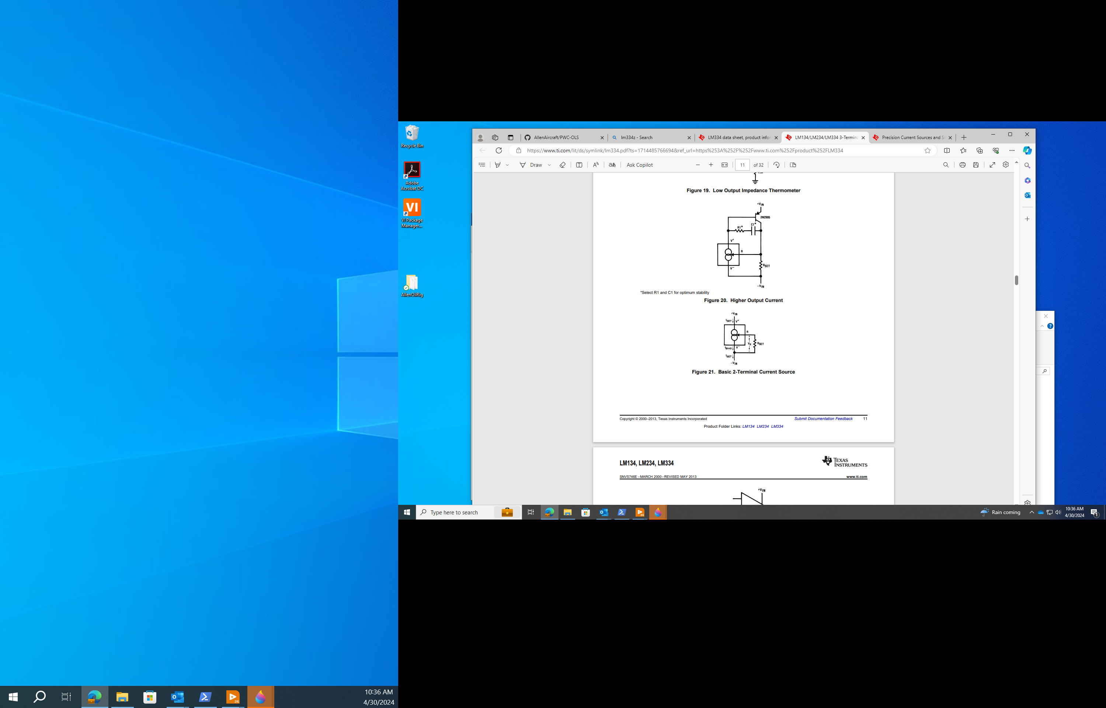
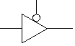
Tri-state
Buffer
Motor
Controller
x4
On/Off
Fwd/Rev
Left
Right
+5Vdc
Do-6
-
+
Ain 0
Do-5
-
+
Do-4
Ain 1
DUT
Sensor
x4
DataQ
DI-2108

Slide 6
ATP Spec Table 1
Index
0 1 2 3 4 5 6 7 8 9 10
Aohm Lo | Aohm Hi | A Fill Lo | A Fill Hi
98 | 102 | 7.91 | 8.01
197 | 203 | 7.46 | 7.56
296 | 304 | 7.01 | 7.11
395 | 405 | 6.56 | 6.66
494 | 506 | 6.11 | 6.21
593 | 607 | 5.66 | 5.76
692 | 708 | 5.21 | 5.31
791 | 809 | 4.76 | 4.86
890 | 910 | 4.31 | 4.41
989 | 1011 | 3.86 | 3.96
1088 | 1112 | 3.41 | 3.51
A Drain Lo | A Drain Hi
7.55 | 7.65
7.10 | 7.20
6.65 | 6.75
6.20 | 6.30
5.75 | 5.85
5.30 | 5.40
4.85 | 4.95
4.40 | 4.50
3.95 | 4.05
3.50 | 3.60
3.05 | 3.15
Empty 98 102 N/A N/A 8.5 N/A
Current
Next
L_{SWP}
₌ ₁₅₀
L_{SWZ}
Next
Current
R_{TH}
R_{TH}
L_{SWZ}
Level
Level
Full 1088 1112 N/A 2.5 N/A N/A

Slide 7

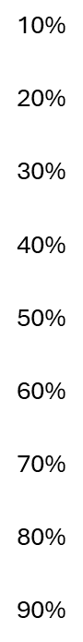
100
200
300
400
500
600
700
800
900
1000
1100
1100
7.910-8.010
7.460-7.560
7.010-7.110
6.560-6.660
6.110-6.210
5.660-5.760
5.210-5.310
4.760-4.860
4.310-4.410
3.860-3.960
3.410-3.510
100
100
200
300
400
500
600
700
800
900
1000
1100
Empty
7.550-7.650
7.100-7.200
6.650-6.750
6.200-6.300
5.750-5.850
5.300-5.400
4.850-4.950
4.400-4.500
3.950-4.050
3.500-3.600
3.050-3.150
FILL
DRAIN
Full
1100

Slide 8
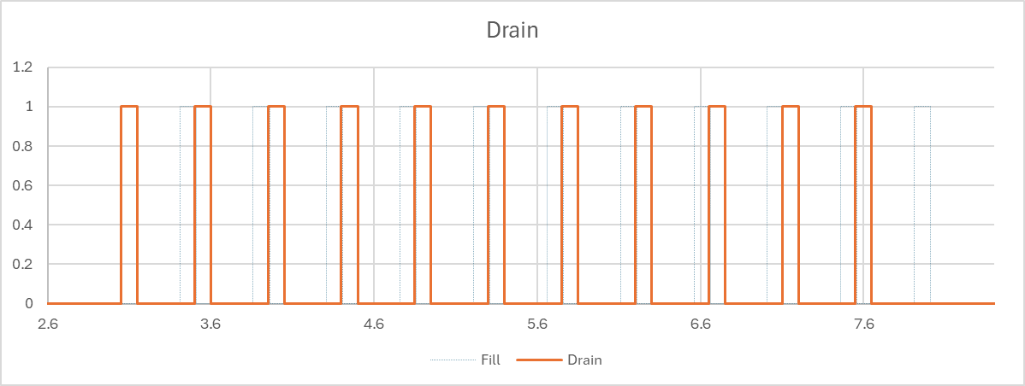
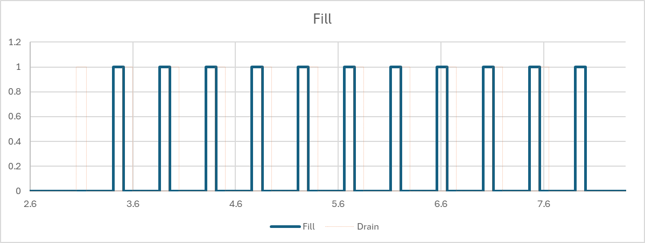
100
200
300
400
500
600
700
800
900
1000
1100
1100
CHA DRAIN
Drain INDEX
Full | 10 | 9 | 8 | 7 | 6 | 5 | 4 | 3 | 2 | 1 | 0 | Empty
100
100
200
300
400
500
600
700
800
900
1000
1100
NO TRANSITION
CHA FILL
Switch Zone
For N=1
Measure R Zone
For N=1
TEST RULES
Resistor must be N.R at Switch Zone limit N.Lo
TEST PROCEDURE NOTES
See Automated ATP Protocol State Diagram.
The order of resistors change N-1.R to N.R during fill phase and N+1.R to N.R during drain phase of test.
Level at which Switch transitions not part of ATP.
Resistor should be in spec in “Measure R Zone else log a warning to be investigated..
Fill INDEX
Full | 10 | 9 | 8 | 7 | 6 | 5 | 4 | 3 | 2 | 1 | 0 | Empty
NO TRANSITION
1.Lo (7.46)
1.Hi (7.56)
Index Spec N= 1 Values
0.Lo (7.91)

Slide 9
Automated ATP Protocol State Diagram
Rev 2 7-16-24
Start
2
KEY
SP Set Point
SwP Switch Point defined as N.Lo for Fill and N.Hi for drain, specified in Table 1.
N Row number from ATP Spec:
10 rows ChA Fill
11 rows of ChB Fill
11 rows ChA Drain
10 rows ChB Drain
N.Lo Low Transition limit for Fill
N.Hi High Transition limit for Drain
N.R Resistance +/- Tolerance
T Stabilization wait time (3 sec??)
States are indicated in boxes.
Transitions indicated by line are the event enabling progression to the next state.
Intent of ATP Procedure
Drive the oil level to Switch Point limit of the next switch zone.
Wait t seconds for the system to stabilize
Measure resistance, verify it has switched.
If Any point fails to switch at SwP, then the part fails
Level and Resistance measurements are collected at 50ms sample rate for post test diagnostic analysis and are NOT part of ATP.
Goto EMPTY
Delay T
Is EMPTY
Timer expired
Pre-Fill
Log Resistance
Is FULL
R out
of spec
1
1
Resist in N.R
OR Err Logged
Pre-Drain
Is EMPTY
N = N+1
Log Error
DONE
Init Record
N=1
Next
N > 42
Measurement R Zone; Out of Spec logged as warning NOT ATP Data
READY
No
Yes
Load Spec N
If Errors
FAIL
Else
PASS
Record Results
READY
Any
R out
of spec
SP = N.Hi (N.Lo)
Resist in N.R
Level Out
of bounds
E-Stop Pump
1
Level = SP
Save & Close
Record
Indicate
Fault
SP=SwP
Stop
Stop
Level = SP
2

Slide 10
Filling Spec for Auto ATP Test
(Draining Spec would be the mirror.)
L_{SWP} Level Switch Point - The next Level measurement after the Resistance measurement is grater than L_{TH} when Filling.
L_{TH} Level Threshold – Average of Resistance Requirement at current level and Resistance Requirement at the next level.
L_{SWZ} Level Switch Zone - From Table 1 (2) Range L_{SWP} must be between for Level to pass.
T_{Rise} Rise Time - The time measure between from 110% of Current R_{M} to 90% of the Next R_{M} Requirement. Passing value from (TBD) Table 3 based on Level Fill/Drain rate. (detects variable resistance)
R_{M} Resistance Measurement - The next Resistance measurement that is recorded after Level measurement is grater than R_{TH} when Filling.
R_{TH} Resistance Threshold. – Average of Maxim Level at the at current Resistance and Minimum Level Requirement at the next Resistance.
R_{R} Resistance Range - R_{M} must be within range cited in Table 1 (2) for Resistance to pass.
Level Pass if L_{SWZLow} <= L_{SWP} <= L_{SWZHigh}
Resistor Pass if R_{RLow} <= R_{M} <= R_{RHigh}
Variable Resistance pass if T_{Rise} < TBD
L_{SWZ}
Level Lo
Level Hi*
300
Resistor
Next
L_{SWP}
L_{TH}
T_{Rise}
200
Resistor
Current
Ω High*
R_{R}
Level Hi
Ω Low*
R_{TH}
LEVEL
Increasing →
R_{M}
This value is from Table 1 (2)
of the ATP Spec.

Slide 11
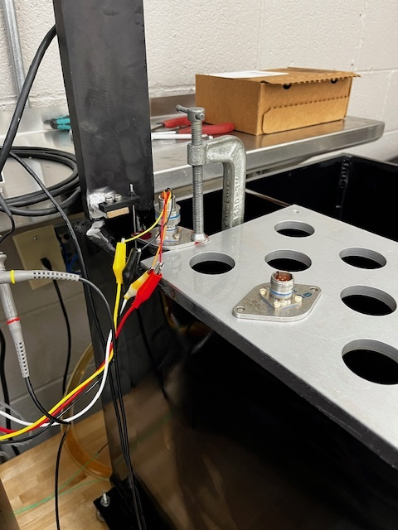
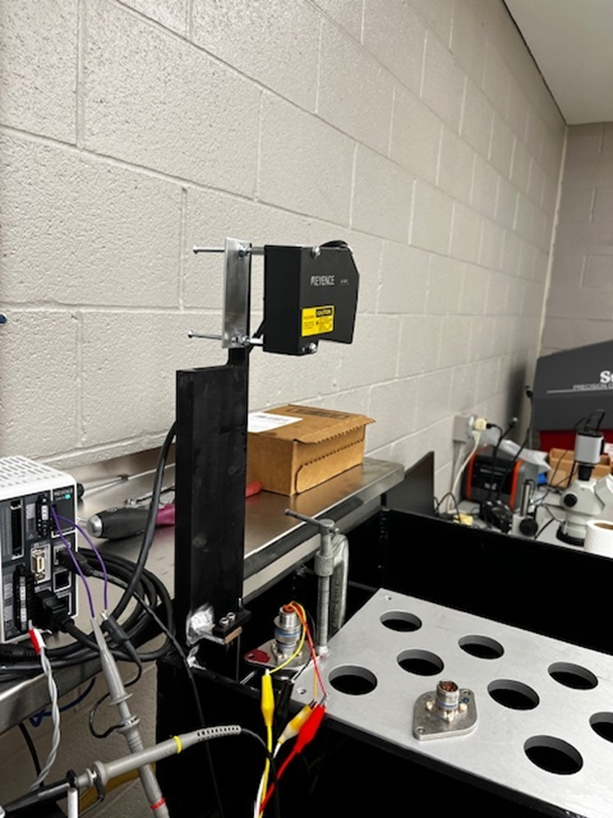
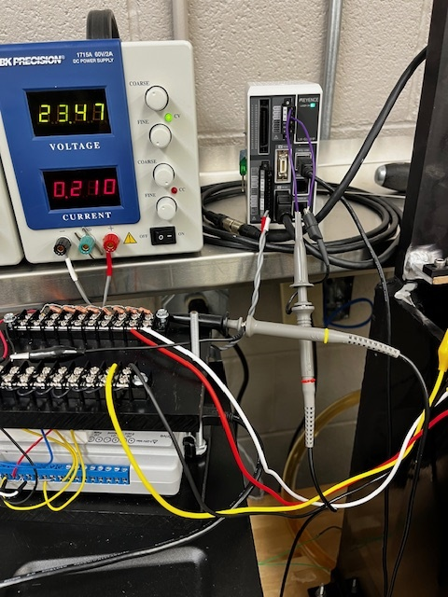

Slide 12
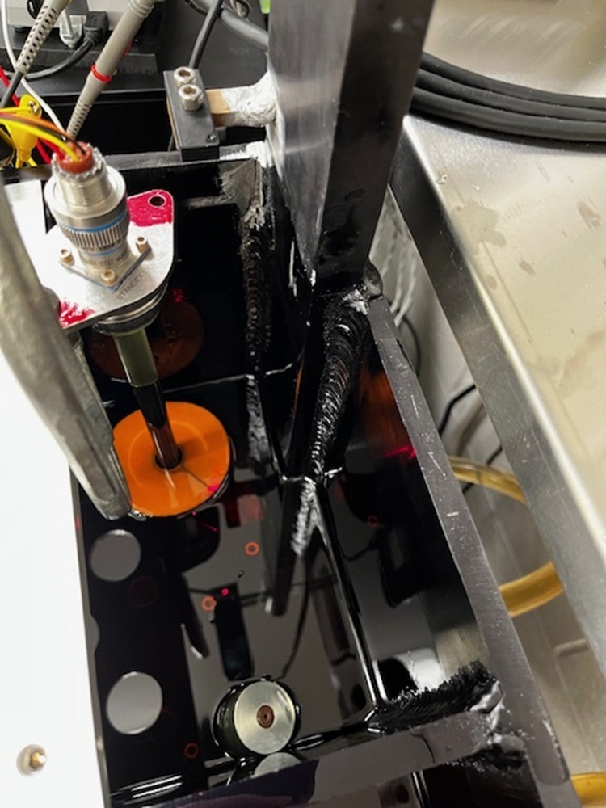
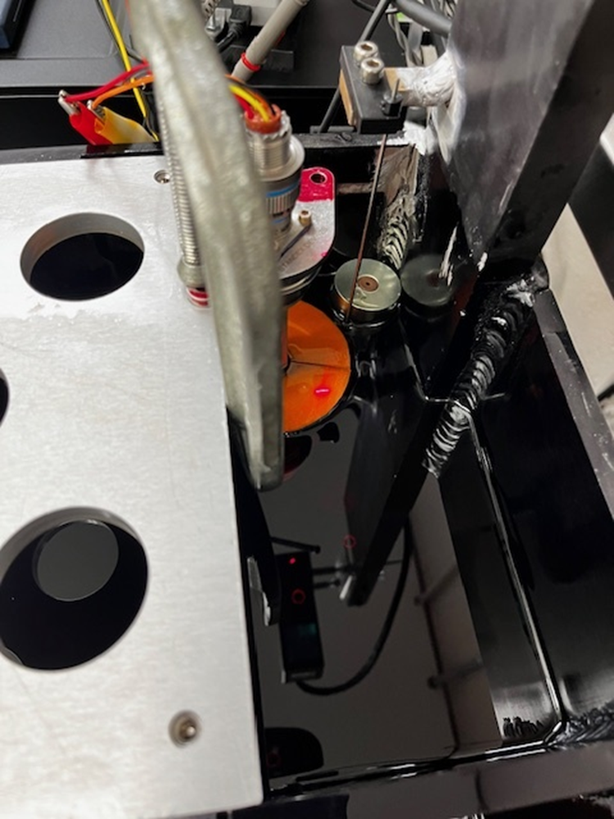

Slide 13
SMT resistor
Reed
Switch
Solder
Pad
PCB
Routed
slot

Slide 14
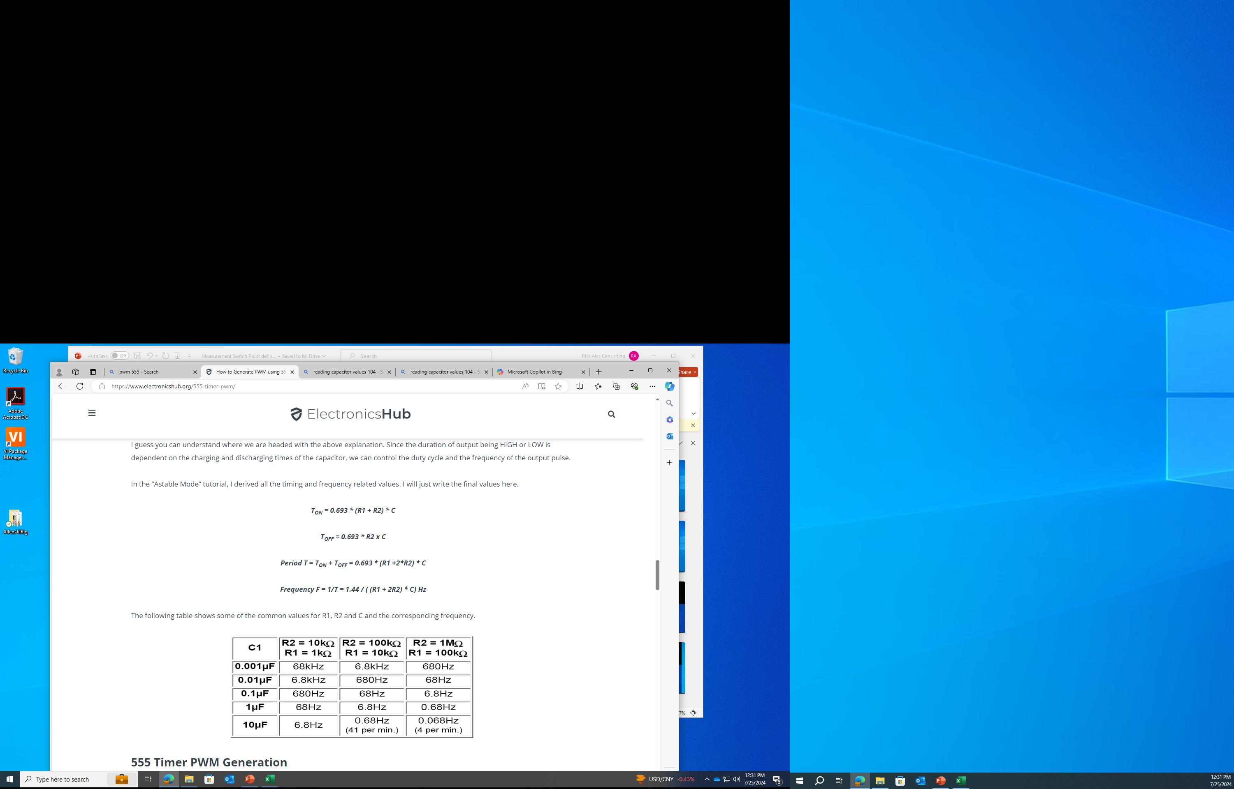
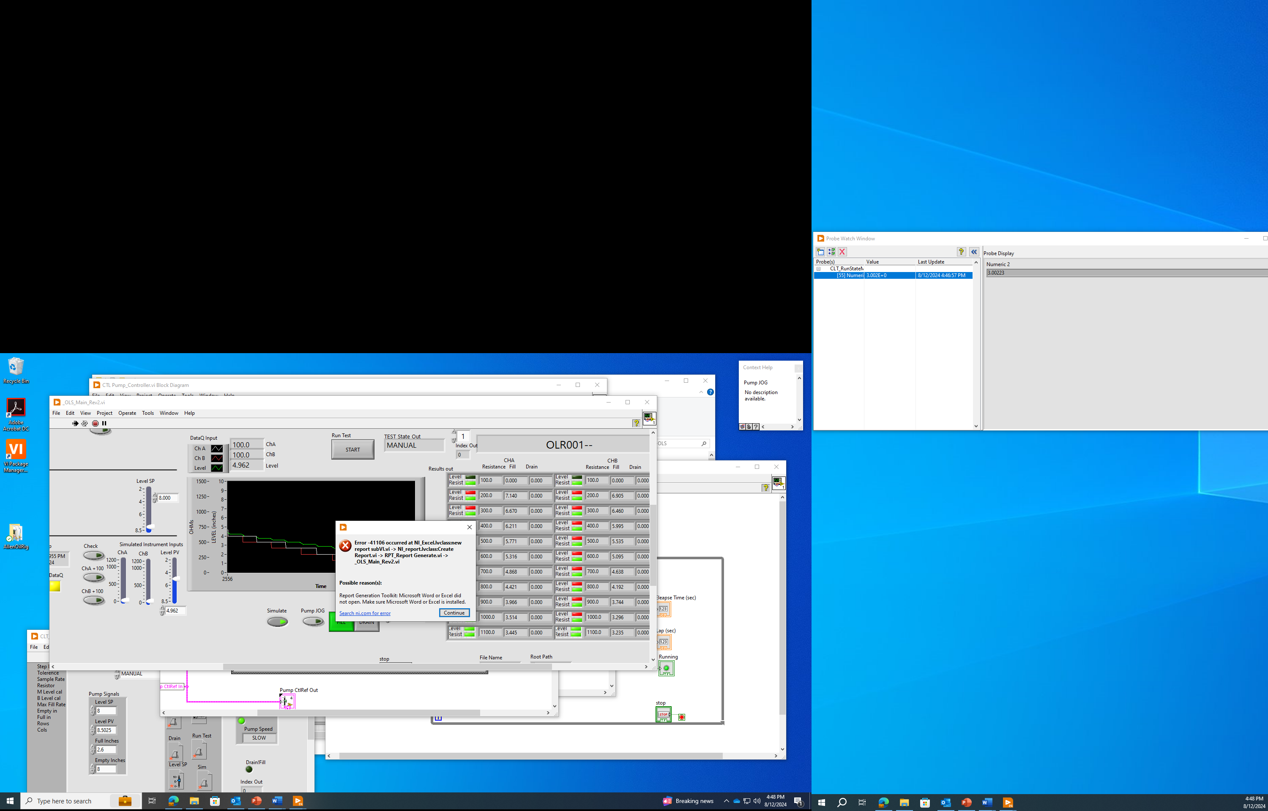


Slide 15
To DataQ support
I am scanning 2 AIs and DI (3 channels) at 50Hz. My Initialization is set as follows:
stop
encode 0
slist 0 0
filter 0 1
slist 1 1
filter 1 1
slist 2 8
srate 10000
ps 0
dec 100
deca 3
endo 120
dout 32
nop
I am using 4 DI as commands as motor control signals (enable, direction, 2-bit speed command). I had tried stopping and starting the stream When sending a dout arg(N) command and waiting for the response, however for some reason sporadically the 2108 would not recognize the dout command. DataQ support suggested I include the DI channel scan list and retry the dout command if the resulting DI channel did not match the dout argument. This kind of works.
However, what I see is when a dout command is issued during the active scan, the scanlist returned is out of sequence. My insequmnece scanlist which is A0, A1, DI, A0, A1, DI ... often becomes DI, A0, A1, DI, A0... or A1, DI, A0, A1.... when I send a dout command while scanning.
How to fix, so the scanlist remains in sequence or reset the scanlist sequence with the dout command?

Slide 16
